Slide 1

operating systems
Recep Tayyip Erdogan University
Faculty of Engineering and Architecture
Computer Engineering Department
Engineering Advisor: Prof. Dr. Yıldıran YILMAZ
Samet SARI 11/18/2021

Slide 2
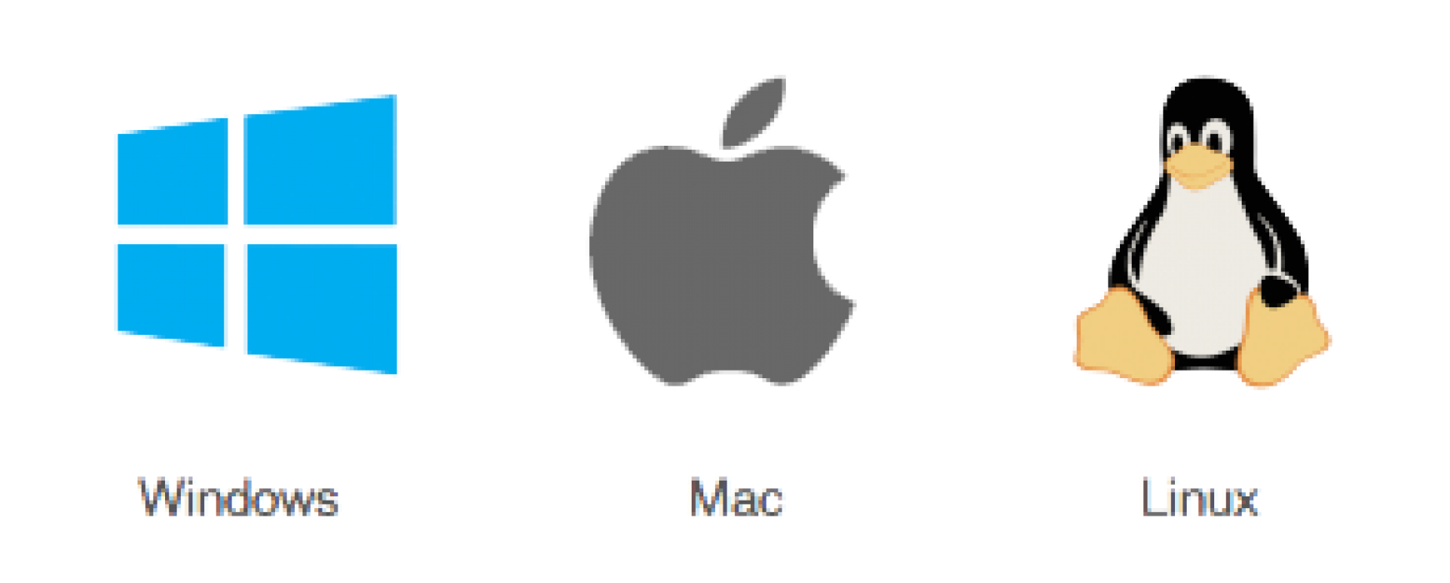
What is operating system?
OS; It is a set of software that manages hardware resources running on the computer and provides common services for various application software.
An operating system is considered the backbone of any system. Without the operating system, the user and system cannot interact. It acts as a mediator between the two. Basically, we have three types of operating systems namely Linux, MAC and Windows.

Slide 3

Microsoft Windows operating system
Microsoft Windows is the most used operating system in the world, developed by the Microsoft company, which approaches the user with graphical interfaces and visual messages, eliminating the need to type from the keyboard such as running software and giving commands.
The first Windows was released on November 20, 1985.

Slide 4

Microsoft Windows operating system
The latest version of the Microsoft Windows operating system is Windows 11, which was released on October 5, 2021. After Windows Vista, Microsoft achieved success with Windows 7 and continued this success with Windows 8 and Windows 10.
Microsoft Windows dominates 90% of the market because it is useful and economical.

Slide 5
Linux operating system
Linux was founded in 1999 by Helsinki University student Linus Torvalds.
It was originally released in 1991 and was designed for GNU developers. GNU developers later integrated it into Linux.
Linux has an open-source structure. This means that the person using the operating system can be aware of almost everything going on in the background of the computer and can organize and develop the operating system by himself.

Slide 6

Linux operating system
One of the first things you'll encounter on Linux will be an oversupply of software updates. Linux is constantly being updated and these updates are usually installed very quickly.
An application that contains a virus on Linux must be approved by the administrator with a password. Applications cannot make any changes to the operating system unless the password is entered. Therefore, Linux protects the computer without the need for any antivirus program.

Slide 7

macOS operating system
macOS, (formerly 'Mac OS X' and 'OS X' is the latest version of the Macintosh family of operating systems and is an operating system designed by Apple Inc. for Macintosh computers.
This operating system is built on Mach microkernel and BSD and is based on Darwin, an open source operating system.

Slide 8
macOS operating system
macOS Server, on the other hand, is a separate operating system for Apple servers, although it is architecturally the same as desktop Mac OS X. Unlike Mac OS X, it includes advanced management tools.
Aqua was developed as the user interface in the Mac OS X operating system. Although the core of the system and some components are open source, most of its components are not open source.

Slide 9
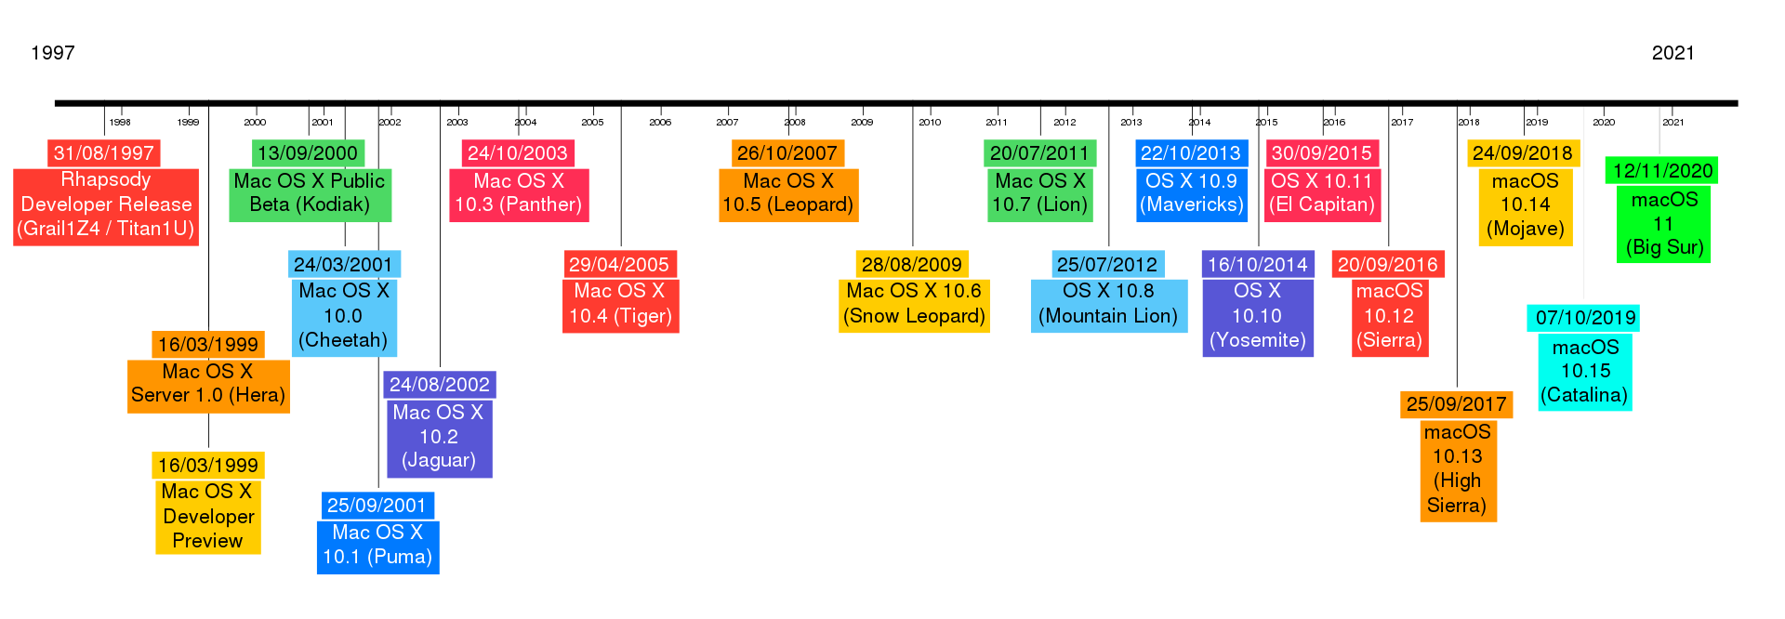
macOS version information

Slide 10
Key Differences Between Linux and MAC and Windows
These are the most used operating systems. Though all three are widely used, there are significant differences between Linux vs MAC vs Windows. Windows is dominant over the other two as 90% of users prefer Windows. Linux is the least used operating system, with users accounting for 1%. MAC is popular and has an overall user base of 7% over the world.

Slide 11
Key Differences Between Linux and MAC and Windows
When it comes to the risk of malware, Windows is the most prone. This is due to a larger user base. Linux is very unlikely to be affected by malware. MAC is similar when it comes to Malware.
Windows is expensive, and the cost starts from $100. Linux is free, and anyone can download and use it. MAC is costlier than Windows, and the user is forced to buy a MAC system built by Apple.

Slide 12
file structure difference
Windows | macOS | Linux
Windows follows a directory structure to store the different kinds of files of the user. It has logical drives and cabinet drawers. It also has folders. Some common folders like documents, pictures, music, videos, and downloads. All these files can be stored in these folders, and also new folders can be created. It also has files which can be a spreadsheet or an application program. It can have extensions as .txt, .jpg etc. | The file structure of MAC is commonly known as MAC OS X. If you go to dig into your MAC’s hard disk through the finder, you will see many directories. The root directory of MAC may encounter when they visit their own MAC book. You can explore the file system and directory structure by going to directories like /Application, /Developer, /sbin, /tmp, etc. | Linux has a completely different file structure form Windows and MAC. It was developed with a different code base. It stores data in the form of a tree. There is a single file tree, and all your drives are mounted over this tree.

Slide 13
Registry difference
Windows | macOS | Linux
Windows registry is a master database that is used to store all settings on your computer. It is responsible for storing all user information with its passwords, and device relate information. The registry also has an editor which allows you to view all keys and values or even drivers if necessary. | MAC stores all application settings in a series of .plist files, which have the various preferences folder in MAC. This .plist file contains all properties in either plain text or binary format. These are stored at: /Library/Preferences folder | Linux also does not have a specific registry of its own. All application setting is stored on a program basis under the different users in the same hierarchy format of the files being stored. There is no centralized database for storing these details, and so periodic cleaning is also not required.

Slide 14
Interchangeable Interfaces difference
Windows | macOS | Linux
Windows interface was not interchangeable until Windows 8. Windows XP had some improvements but not par. Start menu, taskbar, system tray, and Windows Explorer. | MAC has a facility to bridge virtual network interfaces. This can be done by going to system preferences and managing the interfaces. | Linux is easy to switch interfaces. You can switch the environment without having to carry all installations. There are utilities like GNOME and KDE which help in catering to these needs. They help in focusing on different aspects.

Slide 15
Command terminal difference
Windows | macOS | Linux
A terminal or command prompt is a black box ideally used to execute commands. It is also called the Windows Command Processor. It is used to execute commands and different batch files. It can also be used for administrative functions and troubleshoot and solve all windows issues. | MAC provides a console as a terminal application. It has a console, command line, prompt and terminal. A Command-line is used to type your commands. Prompt will provide you with some information and also enable you to run commands. A terminal is an actual interface that will provide the modern graphical user interface as well. You can find the terminal at Applications -> Utilities. | Linux also provides a terminal. You can find terminal at: Applications -> System or Applications -> Utilities. In addition to this, there is also a shell prompt. The most common shell used in bash. It defines how the terminal will behave and look when it is run.

Slide 16
conclusion
All these operating systems have their own pros and cons. It depends on the user and their choices and preferences of what they expect from the operating system. Windows can be used for playing games. Programmers can use Linux, and people who are interested in graphics can use MAC.

Slide 17
references
https://tr.wikipedia.org/wiki/Anasayfa
https://forum.shiftdelete.net/konular/mac-os-windows-linux-isletim-sistemleri-hakkinda.610735/
https://www.teknoloji6.com/mac-isletim-sistemi-nedir-941/
http://www.informatics-tech.com/linux-vs-mac-vs-windows-unbiased-comparison.html
https://web.karabuk.edu.tr/ismail.karas/113/IsletimSistemleri.pdf
https://www.educba.com/linux-vs-mac-vs-windows/
http://web.hitit.edu.tr/dosyalar/duyurular/mustafacosar@hititedutr201020141S8E1N1P.pdf

